Slide 1
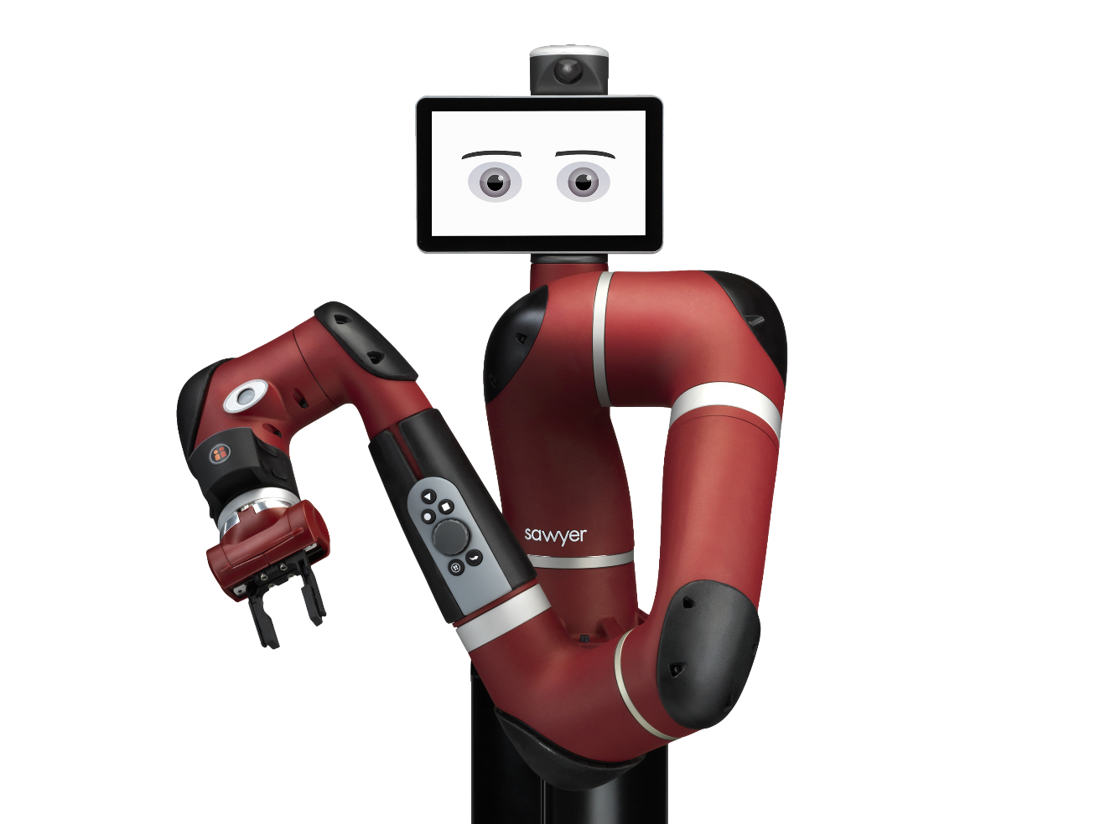
Assistive Robot with EMG Control
Raj Manandhar

Slide 2

Table of Contents
Introduction
Project Development
EMG Sensor
Robot Arm(Sawyer)
Computer Vision with Robot’s Camera
Graphical User Interface (GUI)
Future Development

Slide 3
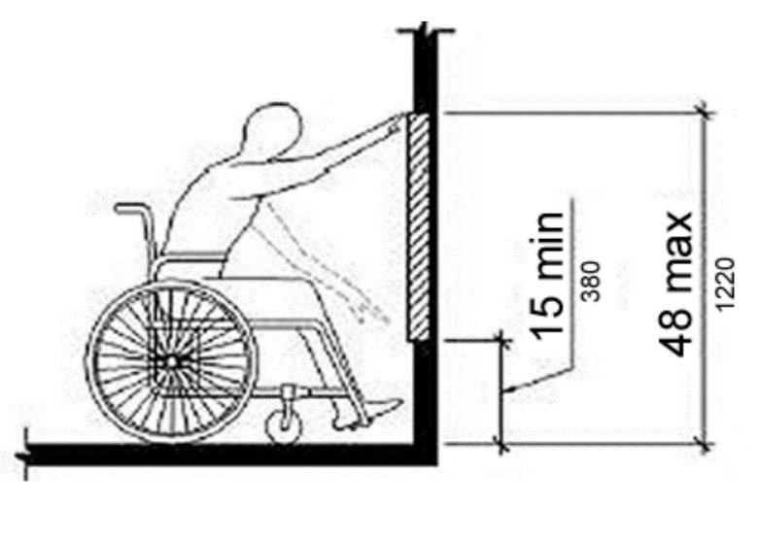
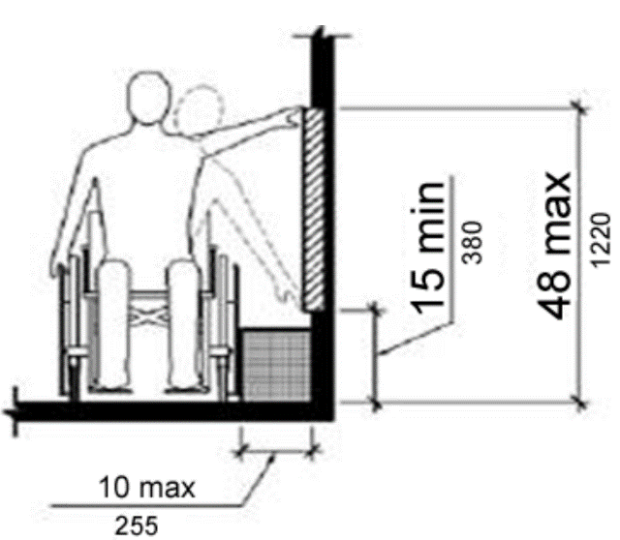
Introduction
Picking objects from a table is a daily task.
On a wheelchair, an individual’s reachability decreases.
Main Goal - The main objective of this project is to get a robotic arm to pick up an object from a table and give it to the user through an easy to use controller.

Slide 4
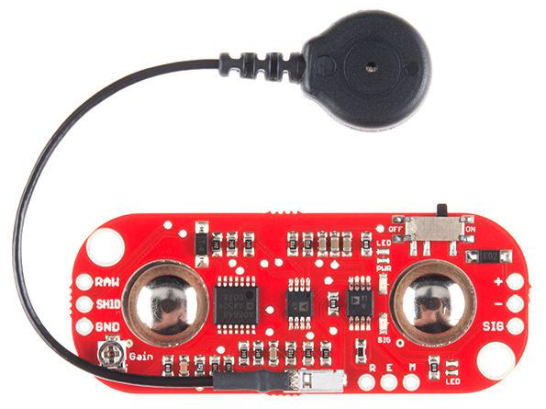
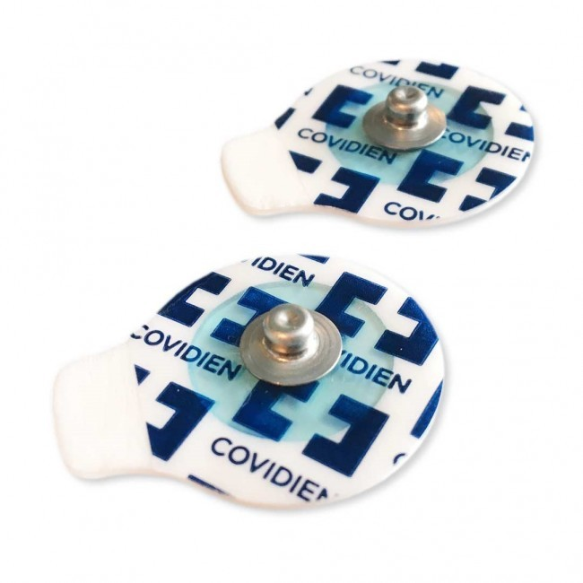
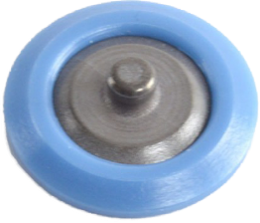
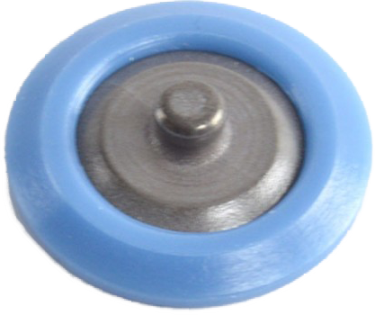
Development : EMG Sensor
Pre processed signal from EMG Sensor.
Check electrodes value and get an appropriate threshold.
Two different types of Electrodes, gelled and non-gelled reusable electrodes.
EMG Sensor
Gelled Electrodes
Non-Gelled Reusable Electrodes

Slide 5
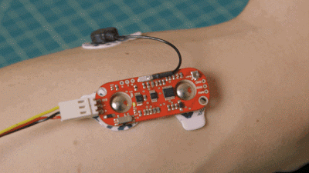
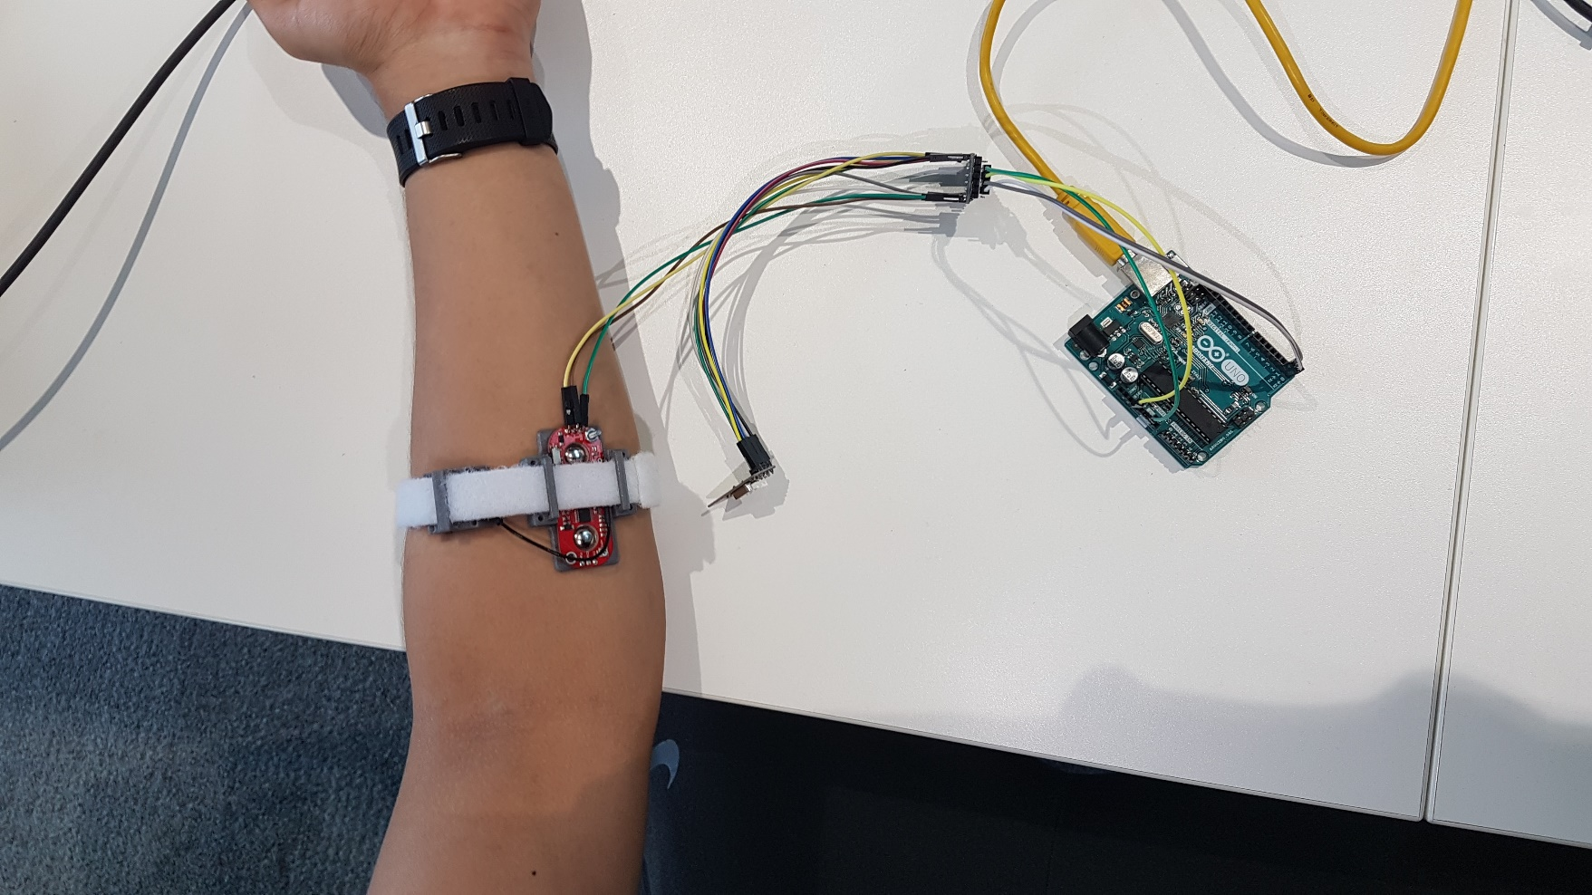
Development : EMG Sensor
Check value on Arduino and record the data
Gelled, max value was 940 while non-gelled electrodes max value was 630.
After few minutes non gelled electrodes stops sending signal due to movement.
Max Value = 940
Max Value = 630

Slide 6
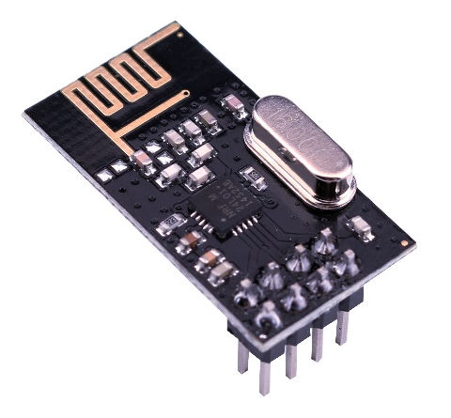
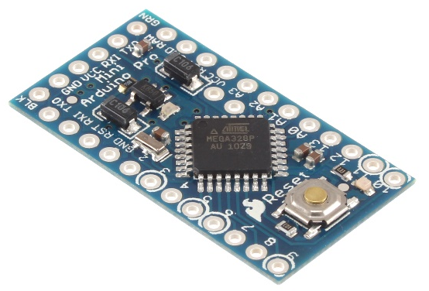
Development : EMG Sensor
Choosing a Wireless Communication device and Microcontroller:
Parameter | Typ. | Units
Supply current in power down | 900 | nA
Transmit current | 11.3 | mA
Receive current | 12.3 | mA
Parameter | Typ. | Units
Power down mode | 0.90 | mA
3.3V on Raw pin | 4.9 | mA
3.3V on Vcc pin | 5.0 | mA

Slide 7

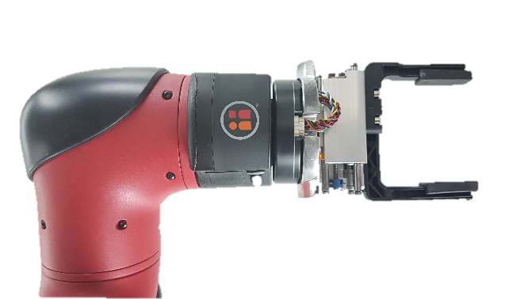
Development : Robot Arm(Sawyer)
Find Orientation for Pick and place
Find Table parameters
Use inverse kinematics
Z = - 0.01m
0.6m
Robot
1.0m

Slide 8

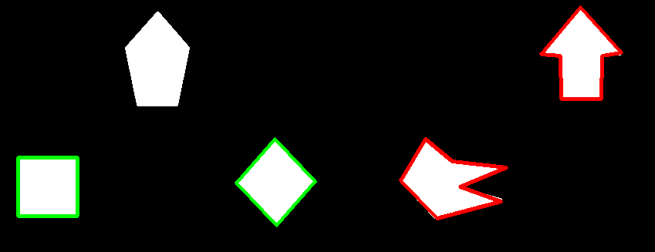
Development : Computer Vision with Robot’s Camera
Different ways to detect object:
Haar Clasifier
Local Binary Pattern(LBP) Classifier
Convolutional Neural Networks
Some other ways to detect objects:
Difference in Colour
Shape detection
Disadvantages:
Training
Object position not found

Slide 9
Development : Computer Vision with Robot’s Camera
Head Camera
Head Camera introduces unwanted objects and would increase processing time.
Hand Camera can eliminated the head camera’s issue as it could look at objects from the top.
Hand Camera
Head Camera | Hand Camera
1280 x 800 | 752 x 480
RGB | Greyscale
No Lighting | Synchronized Embedded Lighting

Slide 10

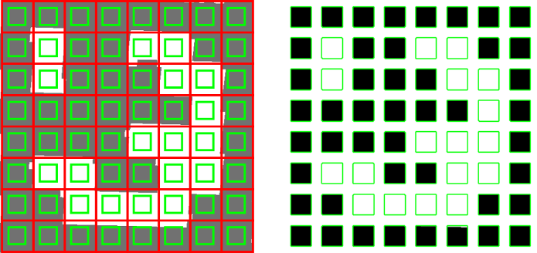
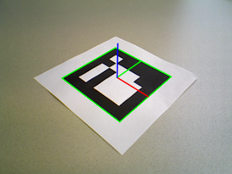
Development : Computer Vision (ArUco Markers)
ArUco Markers easily identifies id’s of the marker.
Future benefits of ArUco makers include position and orientation estimation

Slide 11
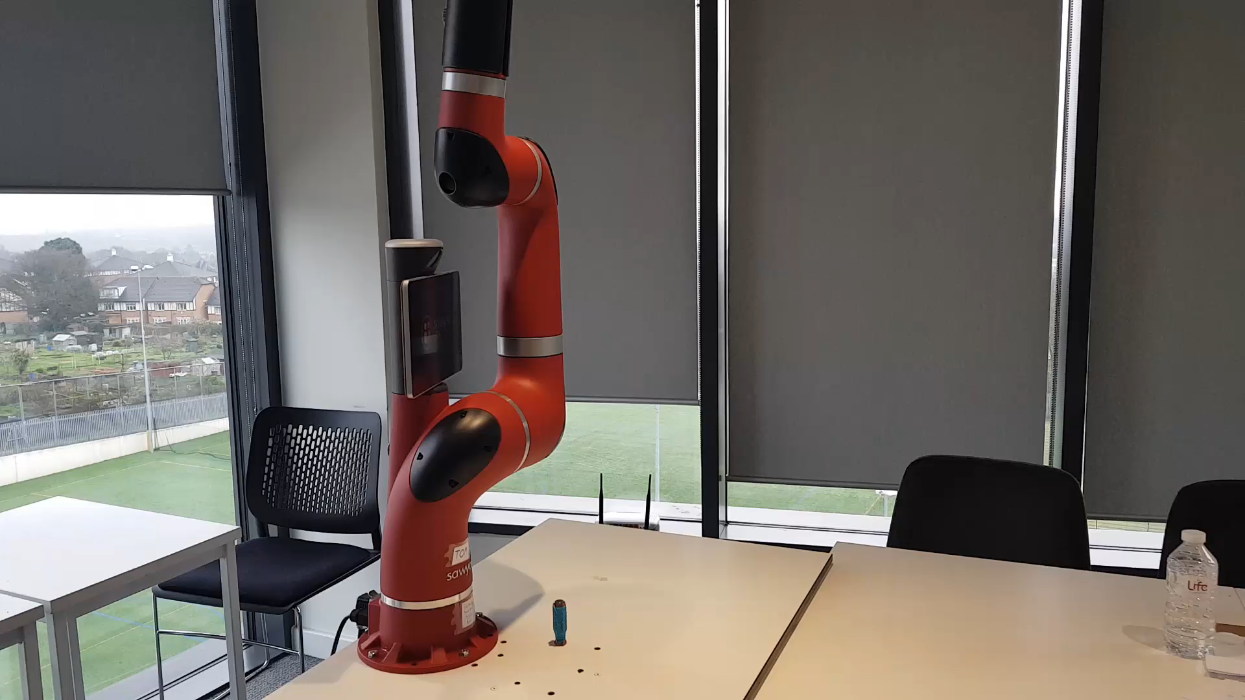
Development : Current System
Permanent location for picking up objects.
Check for object and then Pick and Place
Robot moves in Joint Space
To move Linear the distance is divided with the number of steps wanted. Then in a “For loop” this number is added to the current position.

Slide 12
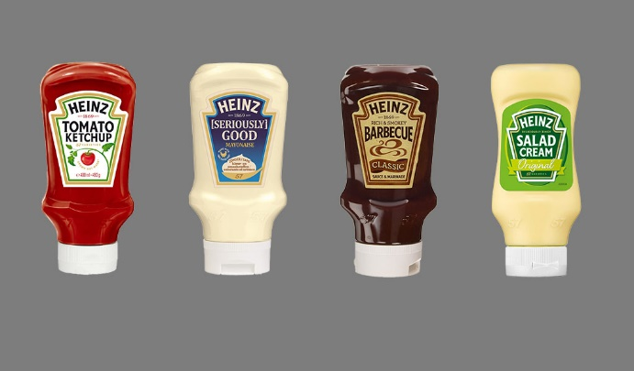
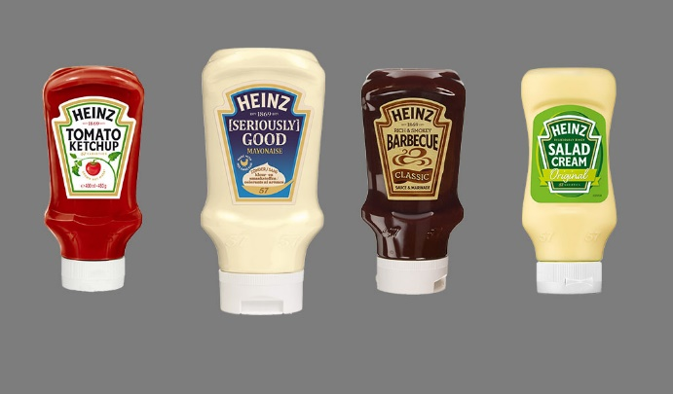
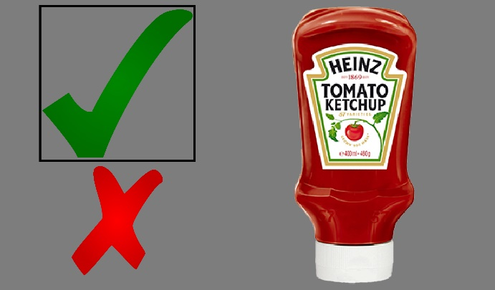
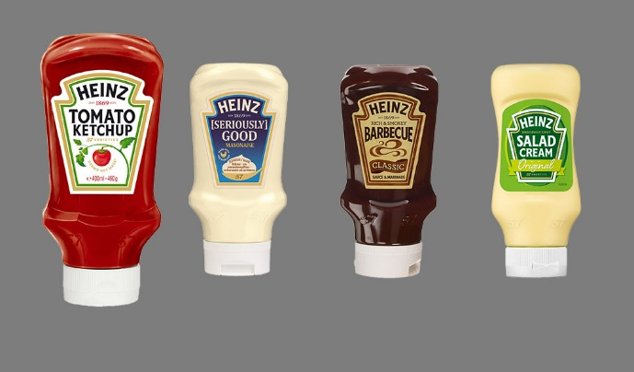
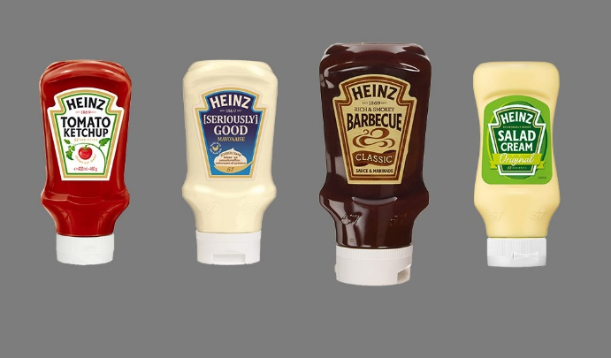
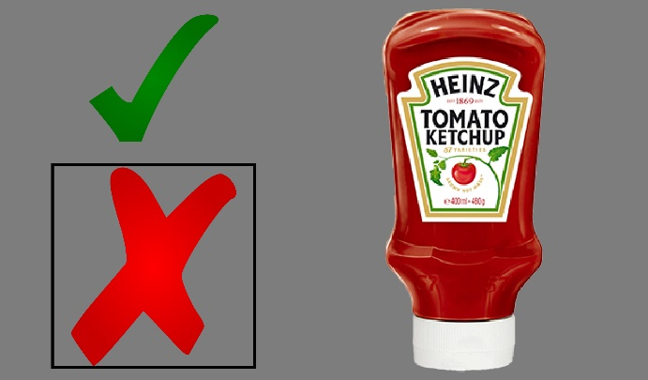
Development : Graphical User Interface
Image based Interface

Slide 13
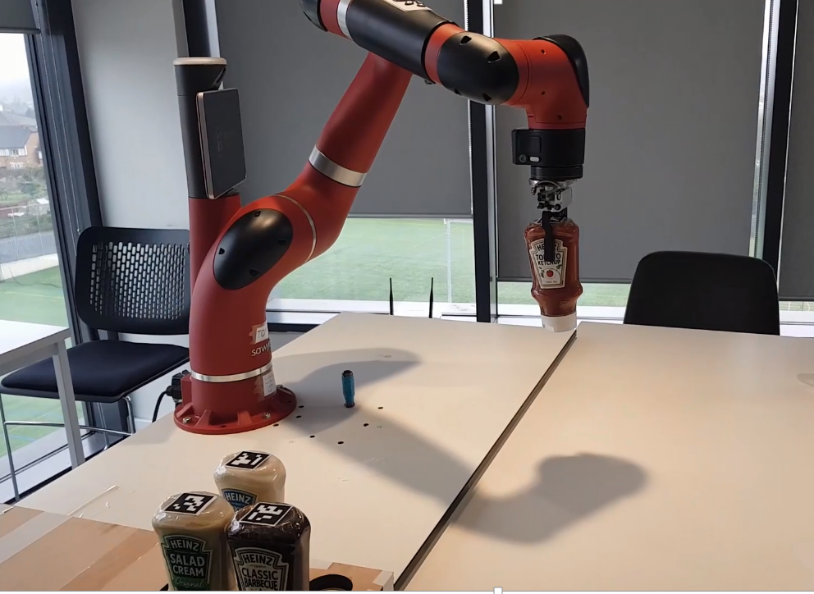
Future Development
3D print the EMG band.
Communication of the EMG band, the GUI and the Robot.
Pick up from dropped location.
Get pose from ArUco Markers.
Find the User.

Slide 14
Summary
Electrodes : Using Non-Reusable Gelled Electrodes
Wireless Communication : RF Transceivers
Microcontroller : Arduino Pro Mini
Robot Arm : Using Cartesian co-ordinates to move to different locations
Camera : Using Right Hand Camera of Sawyer
Object Detection : ArUco Markers
Object Location : Pre-defined locations
GUI : Image Based (every command relates to an image)
Communication between all the systems done through ROS

